Slide 1


Inferential Statistics
09
PART II · FROM DATA TO INSIGHT
CHAPTER 9 · WEEK 6
Data Science — From Foundations to Intelligent Systems
LECTURER
Dr. Mustafa Hameed
THE ISLAMIA UNIVERSITY OF BAHAWALPUR
Bahawalpur, Pakistan
Department of Information Technology · BSIT · Fall 2026
Notes:
Chapter 9: Inferential Statistics. Part 2 — From Data to Insight. Week 6: Inference and causality. Handout pages 55–61.

Slide 2

Where this chapter sits
THE COURSE
PART I
PART II
PART III
PART IV
PART V
PART VI
1
2
3
4
5
6
7
8
9
10
11
12
13
14
15
16
17
18
19
20
21
22
23
24
25
26
27
28
29
30
31
32
Inferential Statistics
BUILDS ON
USED LATER IN
Ch 5 Describing Data: Centre, Spread and Shape
Ch 10 Relationships and Causality
Ch 6 Probability and Uncertainty
Ch 29 Research Methods and Experimental Design
Ch 31 Communicating Data Science
Data Science · Chapter 9 · Inferential Statistics
Handout p. 55 2
Notes:
Place the chapter. Before you start: Chapter 6 — especially the Central Limit Theorem, which is what licenses everything in this chapter — and Chapter 5.

Slide 3

What you will be able to do
LEARNING OUTCOMES
By the end of this chapter you will be able to:
1
Distinguish a population from a sample and identify the sampling method used in a study.
2
Construct and interpret a confidence interval, and state precisely what it does not mean.
3
Conduct a hypothesis test and interpret a p-value correctly.
4
Explain why statistical significance and practical importance are different things, using effect size.
5
Recognise the multiple-comparisons problem and apply a correction.
Data Science · Chapter 9 · Inferential Statistics
Handout p. 55 3
Notes:
Read these out: they are the chapter's contract with the room. Each click adds one.

Slide 4

Vocabulary for this chapter
KEY TERMS
population
sample
sampling bias
standard error
confidence interval
null and alternative hypothesis
p-value
significance level
Type I and Type II error
statistical power
effect size
multiple comparisons
p-hacking
Each term is defined where it first matters — not here.
Data Science · Chapter 9 · Inferential Statistics
Handout p. 55 4
Notes:
Do not define these now; they arrive one at a time. This slide is for the students' notes. Terms: population; sample; sampling bias; standard error; confidence interval; null and alternative hypothesis; p-value; significance level; Type I and Type II error; statistical power; effect size; multiple comparisons; p-hacking.

Slide 5

In this chapter
IN THIS CHAPTER
9.1
From Sample to Population
p. 55 ›
9.2
Confidence Intervals
p. 56 ›
9.3
Hypothesis Testing
p. 57 ›
9.4
Effect Size and Power
p. 58 ›
9.5
Multiple Comparisons
p. 58 ›
Data Science · Chapter 9 · Inferential Statistics
Handout pp. 55–61 5
Notes:
The route through the chapter. Each row is a link: click it to jump to that section in the slide show.

Slide 6
From Sample to Population
SECTION 1 OF 5
9.1
9.1 From Sample to Population
9.2 Confidence Intervals
9.3 Hypothesis Testing
9.4 Effect Size and Power
9.5 Multiple Comparisons
Data Science · Chapter 9
Handout §9.1 6
Notes:
Pause. Name the question this section answers.

Slide 7

Population and Sample
DEFINITION
The population is every unit you want to make a claim about. The sample is the subset you actually measured. Inference is the discipline of saying what the sample entitles you to claim about the population — and, equally, what it does not.
Data Science · Chapter 9 · Inferential Statistics
§9.1 · Handout p. 55 7
Notes:
Read the box aloud, then ask for an example from the room before moving on.

Slide 8

From Sample to Population
AT A GLANCE
Sampling method | How | Bias risk
Simple random | Every unit equally likely | Low, but often impractical
Stratified | Sample within each subgroup | Low; improves precision when groups differ
Cluster | Sample whole groups (e.g. 5 classes) | Moderate; units within a cluster are similar, so effective n is smaller than it looks
Systematic | Every k-th unit | Low unless the data has a matching period
Convenience | Whoever is available | High — the commonest and most damaging method in student projects
Voluntary response | Whoever chooses to reply | High — respondents differ systematically from non-respondents
Data Science · Chapter 9 · Inferential Statistics
§9.1 · Handout p. 55 8
Notes:
Do not read the table row by row: pick the row the room is most likely to get wrong and ask why.

Slide 9

No Sample Size Fixes a Biased Sample
WATCH OUT
If your survey reaches only students who log in to the VLE, no increase in n will tell you anything about students who have stopped logging in — and in a dropout study, those are the population of interest. A large biased sample is more dangerous than a small one, because its narrow confidence interval projects false authority.
Data Science · Chapter 9 · Inferential Statistics
§9.1 · Handout p. 55 9
Notes:
Read the box aloud, then ask for an example from the room before moving on.

Slide 10
Confidence Intervals
SECTION 2 OF 5
9.2
9.1 From Sample to Population
9.2 Confidence Intervals
9.3 Hypothesis Testing
9.4 Effect Size and Power
9.5 Multiple Comparisons
Data Science · Chapter 9
Handout §9.2 10
Notes:
Pause. Name the question this section answers.

Slide 11
Standard Error and Confidence Interval
DEFINITION
The standard error of the mean is SE = s/√n — the typical distance between a sample mean and the true mean. An approximate 95% confidence interval is
Data Science · Chapter 9 · Inferential Statistics
§9.2 · Handout p. 56 11
Notes:
Read the box aloud, then ask for an example from the room before moving on.

Slide 12

A Confidence Interval, and What It Means
WORKED EXAMPLE
A sample of n = 100 support tickets has mean resolution time x̄ = 42 minutes with s = 15 minutes.
Standard error: SE = 15/√(100) = 15/10 = 1.5 minutes.
Margin of error: 1.96 × 1.5 = 2.94 minutes.
95% CI: 42 ± 2.94 = [39.1, 44.9] minutes.
What this means: if you repeated this sampling procedure many times, about 95% of the intervals so constructed would contain the true population mean.
What it does not mean: that there is a 95% probability the true mean lies in this interval. The true mean is a fixed number; it either is or is not in [39.1, 44.9]. The 95% describes the reliability of the procedure, not this one result.
Now quadruple the sample. With n = 400, SE = 15/20 = 0.75 and the interval halves to [40.5, 43.5]. Four times the data for twice the precision — the √n from Chapter 6, in its practical form. Budget accordingly.
Data Science · Chapter 9 · Inferential Statistics
§9.2 · Handout p. 56 12
Notes:
Each click adds one step of the working. Ask for the next number before you reveal it.

Slide 13
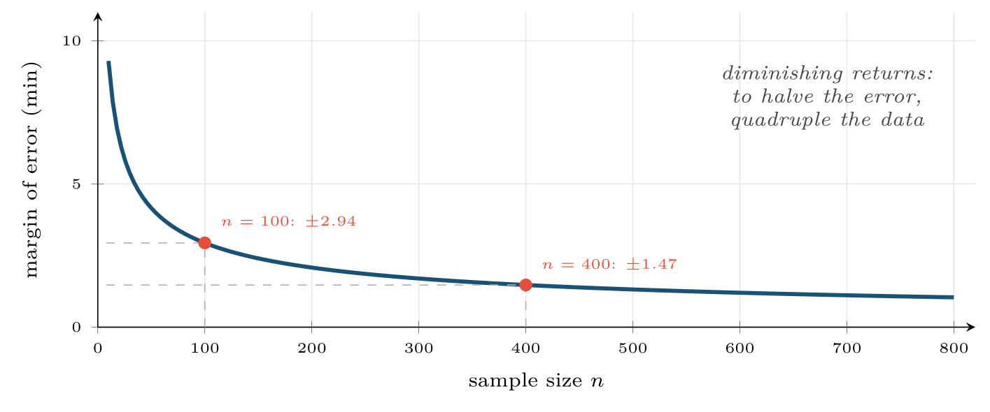
Margin of error against sample size
FIGURE 9.1
The curve is 1.96s/√n. The flat right-hand region is why collecting ten times more data rarely improves a study ten-fold — and why reducing bias usually beats increasing n.
Data Science · Chapter 9 · Inferential Statistics
§9.2 · Handout p. 56 13
Notes:
Figure 9.1 (handout p. 57): Margin of error against sample size. The curve is 1.96s/√n. The flat right-hand region is why collecting ten times more data rarely improves a study ten-fold — and why reducing bias usually beats increasing n.

Slide 14
Hypothesis Testing
SECTION 3 OF 5
9.3
9.1 From Sample to Population
9.2 Confidence Intervals
9.3 Hypothesis Testing
9.4 Effect Size and Power
9.5 Multiple Comparisons
Data Science · Chapter 9
Handout §9.3 14
Notes:
Pause. Name the question this section answers.

Slide 15
Null and Alternative Hypotheses
DEFINITION
The null hypothesis H₀ states there is no effect — no difference, no relationship. The alternative H₁ states there is one. A test asks: if H₀ were true, how surprising would data like mine be?
Data Science · Chapter 9 · Inferential Statistics
§9.3 · Handout p. 57 15
Notes:
Read the box aloud, then ask for an example from the room before moving on.

Slide 16
p-value
DEFINITION
The p-value is the probability of observing data at least as extreme as yours, assuming the null hypothesis is true. Small p means your data would be unusual if there were no effect.
Data Science · Chapter 9 · Inferential Statistics
§9.3 · Handout p. 57 16
Notes:
Read the box aloud, then ask for an example from the room before moving on.

Slide 17
What a p-value Is Not
WATCH OUT
It is not the probability that H₀ is true.
It is not the probability your result was due to chance.
It is not a measure of how large or important the effect is.
p = 0.04 and p = 0.0001 do not mean “true” and “very true”.
Data Science · Chapter 9 · Inferential Statistics
§9.3 · Handout p. 57 17
Notes:
Read the box aloud, then ask for an example from the room before moving on.

Slide 18
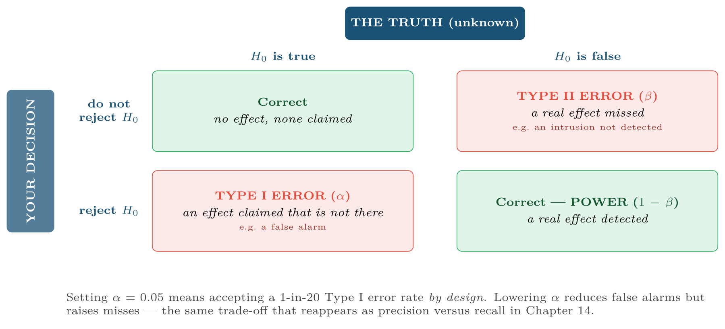
The two errors
FIGURE 9.2
Which one is worse is a domain question, never a statistical one: a Type I error wastes an analyst’s afternoon, a Type II error lets an intrusion through.
Data Science · Chapter 9 · Inferential Statistics
§9.3 · Handout p. 57 18
Notes:
Figure 9.2 (handout p. 57): The two errors. Which one is worse is a domain question, never a statistical one: a Type I error wastes an analyst’s afternoon, a Type II error lets an intrusion through.

Slide 19
Did the New Lab Format Help?
WORKED EXAMPLE
Pass rates: old format 68 of 100 students; new format 79 of 100.
H₀: the true pass rates are equal. H₁: they differ.
Test: two-proportion z-test. Pooled proportion p̂ = (68+79)/200 = 0.735.
p-value: for a two-sided test, p ≈ 0.078.
Decision at α = 0.05: do not reject H₀. The evidence is suggestive but not conclusive.
Data Science · Chapter 9 · Inferential Statistics
§9.3 · Handout p. 57 19
Notes:
Each click adds one step of the working. Ask for the next number before you reveal it.

Slide 20
Did the New Lab Format Help? (continued)
WORKED EXAMPLE
The honest report: “Pass rates rose by 11 percentage points (68% to 79%). This did not reach significance at the 5% level (p = 0.078), which with 100 students per group is unsurprising — the study had roughly 40% power to detect an effect of this size. The observed difference is educationally meaningful and warrants a larger trial, not dismissal.”
The dishonest report: “No significant difference; the new format does not work.” Absence of evidence is not evidence of absence, and with this sample size the test was never capable of settling the question.
Data Science · Chapter 9 · Inferential Statistics
§9.3 · Handout p. 57 20
Notes:
Each click adds one step of the working. Ask for the next number before you reveal it.

Slide 21
Effect Size and Power
SECTION 4 OF 5
9.4
9.1 From Sample to Population
9.2 Confidence Intervals
9.3 Hypothesis Testing
9.4 Effect Size and Power
9.5 Multiple Comparisons
Data Science · Chapter 9
Handout §9.4 21
Notes:
Pause. Name the question this section answers.

Slide 22
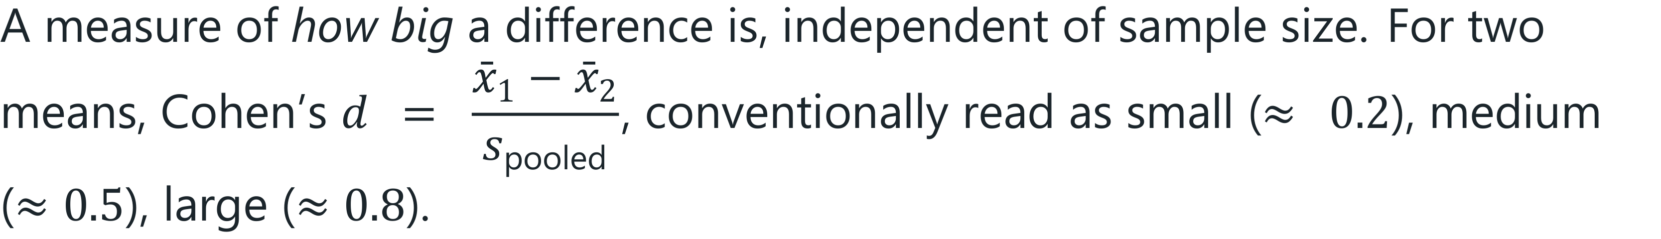
Effect Size
DEFINITION
Data Science · Chapter 9 · Inferential Statistics
§9.4 · Handout p. 58 22
Notes:
Read the box aloud, then ask for an example from the room before moving on.

Slide 23

Why Every Result Needs Both Numbers
CONCEPT
With n = 10 million, a difference of 0.01% in click rate will be highly significant and completely worthless. With n = 20, a difference that would transform the department may not reach significance at all. The p-value tells you whether the effect is detectable; the effect size tells you whether it is worth acting on. Report both, always.
Data Science · Chapter 9 · Inferential Statistics
§9.4 · Handout p. 58 23
Notes:
Read the box aloud, then ask for an example from the room before moving on.

Slide 24
Multiple Comparisons
SECTION 5 OF 5
9.5
9.1 From Sample to Population
9.2 Confidence Intervals
9.3 Hypothesis Testing
9.4 Effect Size and Power
9.5 Multiple Comparisons
Data Science · Chapter 9
Handout §9.5 24
Notes:
Pause. Name the question this section answers.

Slide 25
The Problem
WATCH OUT
At α = 0.05, each test has a 1-in-20 chance of a false positive. Run 20 independent tests on data with no real effects and the probability of at least one “significant” result is 1 − 0.95²⁰ = 64%. Run 100 and it is 99.4%.
This is how a team “discovers” that students born in March do better: they tested enough hypotheses that something had to come up.
Data Science · Chapter 9 · Inferential Statistics
§9.5 · Handout p. 58 25
Notes:
Read the box aloud, then ask for an example from the room before moving on.

Slide 26
Bonferroni Correction
DEFINITION
When running m tests, use α′ = α / m for each. With 20 tests at an overall 5% level, require p < 0.0025 individually. It is conservative — it raises Type II errors — but it is simple and defensible.
Data Science · Chapter 9 · Inferential Statistics
§9.5 · Handout p. 58 26
Notes:
Read the box aloud, then ask for an example from the room before moving on.

Slide 27

p-hacking
COMMON PITFALLS
The defence: write the hypothesis, the test and the success criterion down before you look at the data — exactly the discipline Chapter 2 demanded in framing, and which Chapter 29 formalises as pre-registration.
✕
Testing many outcomes and reporting only the significant ones.
✕
Adding data until p drops below 0.05, then stopping.
✕
Trying several subgroups and reporting the one that worked.
✕
Deciding the hypothesis after seeing the result.
Data Science · Chapter 9 · Inferential Statistics
§9.5 · Handout p. 58 27
Notes:
For each pitfall, ask who has seen it happen. One real story beats five bullets.

Slide 28





Four lenses: Inference in Practice
FOUR LENSES
LEARNING ANALYTICS
PROJECT MANAGEMENT
Comparing pass rates between two teaching formats is a two-proportion test — but students are not independent: they share tutors, timetables and study groups, which is cluster sampling in disguise, so the effective sample is smaller than the headcount.
Sprint samples are small (n ≈ 10–20), so power is low and non-significant results are near-guaranteed.
INTERNET OF THINGS
CYBERSECURITY
With millions of readings, everything is statistically significant — a 0.02°C difference between two sensor batches will have p < 10⁻⁹ and mean nothing.
Type I and Type II errors have wildly asymmetric costs here, so α = 0.05 is an arbitrary import from another field.
Data Science · Chapter 9 · Inferential Statistics
Handout p. 61 28
Notes:
The same method, four domains. Each of the next four slides opens one lens in full.

Slide 29

Learning Analytics: Inference in Practice
FOUR LENSES
LEARNING ANALYTICS
Project Management
Comparing pass rates between two teaching formats is a two-proportion test — but students are not independent: they share tutors, timetables and study groups, which is cluster sampling in disguise, so the effective sample is smaller than the headcount. Always report the effect size in percentage points alongside p, because a statistically significant 0.5-point rise will not justify redesigning a module.
Internet of Things
Cybersecurity
Data Science · Chapter 9 · Inferential Statistics
Handout p. 61 29
Notes:
Learning Analytics. Comparing pass rates between two teaching formats is a two-proportion test — but students are not independent: they share tutors, timetables and study groups, which is cluster sampling in disguise, so the effective sample is smaller than the headcount. Always report the effect size in percentage points alongside p, because a statistically significant 0.5-point rise will not justify redesigning a module.

Slide 30

Project Management: Inference in Practice
FOUR LENSES
PROJECT MANAGEMENT
Learning Analytics
Sprint samples are small (n ≈ 10–20), so power is low and non-significant results are near-guaranteed. Confidence intervals on velocity are far more useful to a team than tests: “we complete 28–41 points per sprint with 95% confidence” supports planning in a way that “p = 0.31” never will.
Internet of Things
Cybersecurity
Data Science · Chapter 9 · Inferential Statistics
Handout p. 61 30
Notes:
Project Management. Sprint samples are small (n ≈ 10–20), so power is low and non-significant results are near-guaranteed. Confidence intervals on velocity are far more useful to a team than tests: “we complete 28–41 points per sprint with 95% confidence” supports planning in a way that “p = 0.31” never will.

Slide 31

Internet of Things: Inference in Practice
FOUR LENSES
INTERNET OF THINGS
Learning Analytics
With millions of readings, everything is statistically significant — a 0.02°C difference between two sensor batches will have p < 10⁻⁹ and mean nothing. In this domain the p-value is almost useless and the effect size is almost everything. Beware also that consecutive readings are autocorrelated, so the effective sample size is far below the row count.
Project Management
Cybersecurity
Data Science · Chapter 9 · Inferential Statistics
Handout p. 61 31
Notes:
Internet of Things. With millions of readings, everything is statistically significant — a 0.02°C difference between two sensor batches will have p < 10−9 and mean nothing. In this domain the p-value is almost useless and the effect size is almost everything. Beware also that consecutive readings are autocorrelated, so the effective sample size is far below the row count.

Slide 32

Cybersecurity: Inference in Practice
FOUR LENSES
CYBERSECURITY
Learning Analytics
Type I and Type II errors have wildly asymmetric costs here, so α = 0.05 is an arbitrary import from another field. Set the threshold from the cost ratio instead (Chapter 6’s expected-value calculation). Multiple comparisons are acute: a SIEM testing thousands of rules per hour will generate false positives continuously by construction unless corrected.
Project Management
Internet of Things
Data Science · Chapter 9 · Inferential Statistics
Handout p. 61 32
Notes:
Cybersecurity. Type I and Type II errors have wildly asymmetric costs here, so α = 0.05 is an arbitrary import from another field. Set the threshold from the cost ratio instead (Chapter 6’s expected-value calculation). Multiple comparisons are acute: a SIEM testing thousands of rules per hour will generate false positives continuously by construction unless corrected.

Slide 33

Try it yourself: Interval, Test and Effect Size
TRY IT YOURSELF
WHAT YOU WILL DO
1. Confidence interval for the new format's pass rate
2. Hypothesis test
3. Effect size: report this WITH the p-value, never instead of it
4. The multiple-comparisons demonstration
THIS WEEK'S LAB
WHAT YOU WILL RUN
Week 6: Intervals, tests, confounder simulation
1 listing, 24 lines of Python
Data Science · Chapter 9 · Inferential Statistics
§9.5 · Handout p. 58 33
Notes:
Say what the room will have at the end of the lab, then let them start. Circulate rather than lecture.

Slide 34
Interval, Test and Effect Size
LAB · STEP 1 OF 5
Set-up
Python
1
2
3
4
5
import numpy as np
from scipy import stats
old = np.array([0]*32 + [1]*68) # 68 of 100 passed
new = np.array([0]*21 + [1]*79) # 79 of 100 passed
Data Science · Chapter 9 · Inferential Statistics
§9.5 · Handout p. 58 34
Notes:
Step 1: Set-up. Read the code aloud; ask what each line would print before running it.

Slide 35
Interval, Test and Effect Size
LAB · STEP 2 OF 5
Confidence interval for the new format's pass rate
Python
6
7
8
9
# --- confidence interval for the new format's pass rate ---------------
p, n = new.mean(), len(new)
se = np.sqrt(p*(1-p)/n)
print(f"new pass rate: {p:.2f} 95% CI [{p-1.96*se:.3f}, {p+1.96*se:.3f}]")
Data Science · Chapter 9 · Inferential Statistics
§9.5 · Handout p. 58 35
Notes:
Step 2: Confidence interval for the new format's pass rate. Read the code aloud; ask what each line would print before running it.

Slide 36
Interval, Test and Effect Size
LAB · STEP 3 OF 5
Hypothesis test
Python
10
11
12
# --- hypothesis test --------------------------------------------------
t, pval = stats.ttest_ind(new, old)
print(f"t = {t:.2f}, p = {pval:.4f}")
Data Science · Chapter 9 · Inferential Statistics
§9.5 · Handout p. 58 36
Notes:
Step 3: Hypothesis test. Read the code aloud; ask what each line would print before running it.

Slide 37
Interval, Test and Effect Size
LAB · STEP 4 OF 5
Effect size: report this WITH the p-value, never instead of it
Python
13
14
15
# --- effect size: report this WITH the p-value, never instead of it ---
pooled = np.sqrt((old.std(ddof=1)**2 + new.std(ddof=1)**2) / 2)
print(f"Cohen's d = {(new.mean()-old.mean())/pooled:.3f}")
Data Science · Chapter 9 · Inferential Statistics
§9.5 · Handout p. 58 37
Notes:
Step 4: Effect size: report this WITH the p-value, never instead of it. Read the code aloud; ask what each line would print before running it.

Slide 38
Interval, Test and Effect Size
LAB · STEP 5 OF 5
The multiple-comparisons demonstration
Python
16
17
18
19
20
# --- the multiple-comparisons demonstration ---------------------------
rng = np.random.default_rng(0)
hits = sum(stats.ttest_ind(rng.normal(size=50), rng.normal(size=50)).pvalue < 0.05
for _ in range(20))
print(f"'significant' results from 20 tests on pure noise: {hits}")
Data Science · Chapter 9 · Inferential Statistics
§9.5 · Handout p. 58 38
Notes:
Step 5: The multiple-comparisons demonstration. Read the code aloud; ask what each line would print before running it.

Slide 39
What the lab shows
TRY IT YOURSELF
Run the last block a few times. It is drawing from identical distributions every time, so every “significant” result is false. Seeing this happen is more convincing than being told it happens.
Data Science · Chapter 9 · Inferential Statistics
§9.5 · Handout p. 58 39
Notes:
Read the box aloud, then ask for an example from the room before moving on.

Slide 40

A 95% CI for mean response time is [210, 260] ms. Is the statement “there is a 95% chance the true mean is between 210 and 260” correct? If not, state the correct interpretation.
CHECKPOINT 1 OF 3
Discuss with the person next to you, then advance.
Data Science · Chapter 9 · Inferential Statistics
Handout p. 61 · answers in Appendix D 40
Notes:
Ask the room. Do not advance until someone commits to an answer.

Slide 41

A 95% CI for mean response time is [210, 260] ms. Is the statement “there is a 95% chance the true mean is between 210 and 260” correct? If not, state the correct interpretation.
CHECKPOINT 1 OF 3 · ANSWER
Not correct. The true mean is a fixed number, not a random one. The correct statement: if the sampling procedure were repeated many times, about 95% of the intervals so constructed would contain the true mean.
Data Science · Chapter 9 · Inferential Statistics
Handout p. 61 · answers in Appendix D 41
Notes:
Answer (Appendix D): Not correct. The true mean is a fixed number, not a random one. The correct statement: if the sampling procedure were repeated many times, about 95% of the intervals so constructed would contain the true mean.

Slide 42
A study reports p = 0.001 with n = 500,000 and a difference of 0.03%. Should the organisation act on it?
CHECKPOINT 2 OF 3
Discuss with the person next to you, then advance.
Data Science · Chapter 9 · Inferential Statistics
Handout p. 61 · answers in Appendix D 42
Notes:
Ask the room. Do not advance until someone commits to an answer.

Slide 43
A study reports p = 0.001 with n = 500,000 and a difference of 0.03%. Should the organisation act on it?
CHECKPOINT 2 OF 3 · ANSWER
No. With n=500,000 almost any difference is statistically significant. A 0.03% effect is almost certainly not worth acting on. Significance answers “is it detectable?”; effect size answers “is it worth anything?”
Data Science · Chapter 9 · Inferential Statistics
Handout p. 61 · answers in Appendix D 43
Notes:
Answer (Appendix D): No. With n=500,000 almost any difference is statistically significant. A 0.03% effect is almost certainly not worth acting on. Significance answers “is it detectable?”; effect size answers “is it worth anything?”

Slide 44
You test 15 features for association with an outcome at α = 0.05. Roughly what is the chance of at least one false positive if none are genuinely associated?
CHECKPOINT 3 OF 3
Discuss with the person next to you, then advance.
Data Science · Chapter 9 · Inferential Statistics
Handout p. 61 · answers in Appendix D 44
Notes:
Ask the room. Do not advance until someone commits to an answer.

Slide 45
You test 15 features for association with an outcome at α = 0.05. Roughly what is the chance of at least one false positive if none are genuinely associated?
CHECKPOINT 3 OF 3 · ANSWER
1 − 0.95¹⁵ ≈ 54%. More than half the time you would find at least one “significant” result even if nothing were associated.
Data Science · Chapter 9 · Inferential Statistics
Handout p. 61 · answers in Appendix D 45
Notes:
Answer (Appendix D): 1 − 0.9515 ≈ 54%. More than half the time you would find at least one “significant” result even if nothing were associated.

Slide 46

What to take away
CHAPTER SUMMARY
1
Inference generalises from sample to population; a biased sample cannot be rescued by size.
2
A confidence interval describes the reliability of the procedure, not the probability of this particular interval.
3
Precision improves only as √n — quadruple the data to halve the error.
4
A p-value is P(data this extreme ∣ H₀). It is not the probability that H₀ is true, and it says nothing about effect size.
5
Type I errors are false alarms, Type II are misses; which is worse is a domain judgement.
6
Report effect size with every p-value, and correct for multiple comparisons or expect to find things that are not there.
Data Science · Chapter 9 · Inferential Statistics
Handout p. 61 46
Notes:
Ask the room to say each takeaway before you reveal it.

Slide 47

Quick check 1 of 2
REVIEW · MULTIPLE CHOICE
The p-value is the probability of:
A
H₀ being true
B
data at least this extreme given H₀
C
a Type II error
D
the effect being large
Data Science · Chapter 9 · Inferential Statistics
Handout p. 61 47
Notes:
Take a show of hands for each option before discussing. (The handout does not print MCQ answers.)

Slide 48
Quick check 2 of 2
REVIEW · MULTIPLE CHOICE
To halve a confidence interval’s width you must multiply the sample size by:
A
2
B
4
C
√2
D
10
Data Science · Chapter 9 · Inferential Statistics
Handout p. 61 48
Notes:
Take a show of hands for each option before discussing. (The handout does not print MCQ answers.)

Slide 49
For your notebook
REVIEW QUESTIONS
SHORT
Define Type I and Type II errors and give a security example of each with its practical cost.
SHORT
Explain why voluntary-response sampling is especially dangerous in a study of student disengagement.
SHORT
Why does an IoT dataset of ten million readings make p-values nearly useless?
APPLIED
A trial compares two intrusion detection configurations over 30 days. Config A raised 220 alerts of which 14 were real; config B raised 95 of which 11 were real. Set up the hypotheses, say which test you would run, and explain what effect size you would report to management.
APPLIED
A colleague tests 40 candidate features against an outcome and reports the three with p < 0.05. Explain what is wrong, compute the Bonferroni-corrected threshold, and describe a defensible procedure they should have followed instead.
Data Science · Chapter 9 · Inferential Statistics
Handout p. 61 49
Notes:
Set these for independent study. Model answers are not printed in the handout.

Slide 50
End of Chapter 9
09
NEXT
READ
Chapter 10 — Relationships and Causality
Handout Chapter 9, pages 55–61
THIS WEEK'S LAB
Intervals, tests, confounder simulation
Data Science · Chapter 9 · Inferential Statistics
50
Notes:
Close. NEXT: Chapter 10 — Relationships and Causality. READ: Handout Chapter 9, pages 55–61. THIS WEEK'S LAB: Intervals, tests, confounder simulation.

